Slide 1


Hanna Kiyko
09.03.2923

Slide 2

Outline
Executive Summary
Introduction
Methodology
Results
Conclusion
Appendix

Slide 3
Executive Summary
I collect information from various sources, process it and study what parameters and how the success of landing depends
I train and test various machine learning models to obtain a prediction of the success of landing, and therefore the cost of the project.

Slide 4
Introduction
The commercial space age is here, companies are making space travel affordable for everyone. One reason SpaceX can do this is the rocket launches are relatively inexpensive. much of the savings is because SpaceX can reuse the first stage.
Therefore, if we can determine if the first stage will land, we can determine the cost of a launch.

Slide 5

Section 1

Slide 6
Methodology
Executive Summary
Data collection methodology:
Describe how data was collected
Perform data wrangling
Describe how data was processed
Perform exploratory data analysis (EDA) using visualization and SQL
Perform interactive visual analytics using Folium and Plotly Dash
Perform predictive analysis using classification models
How to build, tune, evaluate classification models

Slide 7
Data Collection
we will be working with SpaceX launch data that is gathered from an API, specifically the SpaceX REST API.
you will be using the Python BeautifulSoup package to web scrape some HTML tables that contain valuable Falcon 9 launch records.

Slide 8


spacex_url="https://api.spacexdata.com/v4/launches/past"
response = requests.get(spacex_url)
Data Collection – SpaceX API
The SpaceX REST API endpoints, or URL, starts with api.spacexdata.com/v4/. We will be working with the endpoint api.spacexdata.com/v4/launches/past.
https://github.com/KiykoHanna/CourseraProgect/blob/main/jupyter-labs-spacex-data-collection-api.ipynb
This Photo by Unknown author is licensed under CC BY.

Slide 9
static_url = "https://en.wikipedia.org/w/index.php?title=List_of_Falcon_9_and_Falcon_Heavy_launches&oldid=1027686922"
resp = requests.get(static_url).text
soup = BeautifulSoup(resp,"html5lib")
html_tables = soup.find_all('table')
Data Collection - Scraping
I will be using the Python BeautifulSoup package to web scrape some HTML tables that contain valuable Falcon 9 launch records.
https://github.com/KiykoHanna/CourseraProgect/blob/main/jupyter-labs-webscraping.ipynb

Slide 10
Data Wrangling
I perform some Exploratory Data Analysis (EDA) to find some patterns in the data and determine what would be the label for training supervised models.
https://github.com/KiykoHanna/CourseraProgect/blob/main/labs-jupyter-spacex-Data%20wrangling.ipynb

Slide 11
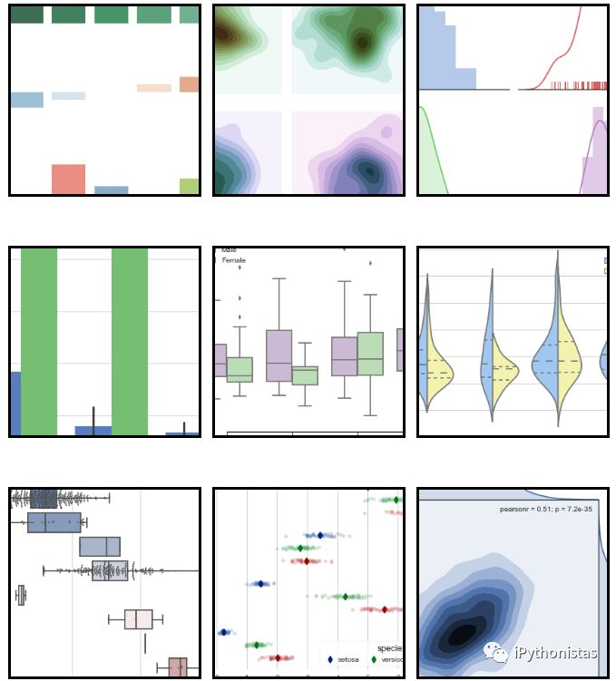
EDA with Data Visualization
We use the Python modul: Seaborn.
scatterplot
barplot
catplot
lineplot
https://github.com/KiykoHanna/CourseraProgect/blob/main/jupyter-labs-eda-dataviz.ipynb

Slide 12
conn = sqlite3.connect("D:\study\python\py-n\coursera\DS_LAST_PROJECT\my_data1.db") # open a database connection
cur = conn.cursor()
cur.execute('SELECT name FROM sqlite_master WHERE type="table"')
print(cur.fetchall())
Q= """
SELECT * FROM SPACEXTBL
"""
cur.execute(Q)
pd.read_sql_query(Q,conn)
EDA with SQL
I perform some Exploratory Data Analysis using a database.
I can see that the data can be used to automatically determine if the Falcon 9’s second stage will land.
ub.com/KiykoHanna/CourseraProgect/blob/main/jupyter-labs-eda-sql-coursera.ipynb

Slide 13

Build an Interactive Map with Folium
After I plot distance lines to the proximities, I can answer the following questions easily:
* Are launch sites in close proximity to railways?
* Are launch sites in close proximity to highways?
* Are launch sites in close proximity to coastline?
* Do launch sites keep certain distance away from cities?
https://github.com/KiykoHanna/CourseraProgect/blob/main/lab_jupyter_launch_site_location.ipynb

Slide 14

Build a Dashboard with Plotly Dash
This dashboard application contains input components such as a dropdown list and a range slider to interact with a pie chart and a scatter point chart.
I can use it to find more insights from the SpaceX dataset more easily than with static graphs.
https://github.com/KiykoHanna/CourseraProgect/blob/main/spacex_dash_app.py

Slide 15
Predictive Analysis (Classification)
I build a machine learning pipeline to predict if the first stage of the Falcon 9 lands successfully.
My project include:
Preprocessing, to standardize our data,
Train_test_split, to split our data into training and testing data,
Train the model and perform Grid Search, to find the hyperparameters that allow a given algorithm to perform best.
Using the best hyperparameter values, I determine the model with the best accuracy using the training data.
I test Logistic Regression, Support Vector machines, Decision Tree Classifier, and K-nearest neighbors.
Finally, I output the confusion matrix.

Slide 16
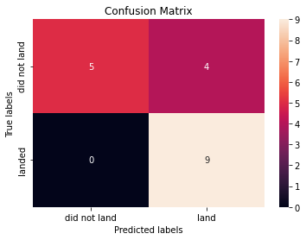
Results
I Find best Hyperparameter for LogisticRegression, SVM, Classification Trees and KNN:
LogisticRegression:'C': 1, 'penalty': 'l2', 'solver': 'lbfgs'
accuracy : 0.9444444444444444
SVM: kernel='sigmoid', 'C': 0.001, 'gamma': 0.001
accuracy : 0.7222222222222222
Classification Trees: 'criterion': 'gini', 'max_depth': 16, 'max_features': 'sqrt', 'min_samples_leaf': 1, 'min_samples_split': 10, 'splitter': 'random'
accuracy : 0.8333333333333334
KNN: 'algorithm': 'auto', 'n_neighbors': 7, 'p': 1
accuracy : 0.6111111111111112
https://colab.research.google.com/gist/KiykoHanna/d16b5f4683f650c84a8a3c2e24a2e30e/ibm_ds0321en_skillsnetwork_labs_module_4_spacex_machine_learning_prediction_part_5_jupyterlite.ipynb

Slide 17

Section 2

Slide 18
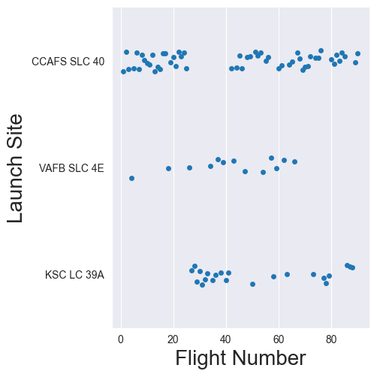
Flight Number vs. Launch Site
sns.catplot(y="LaunchSite", x="FlightNumber", data=df, )
plt.xlabel("Flight Number",fontsize=20)
plt.ylabel("Launch Site",fontsize=20)
plt.show()

Slide 19
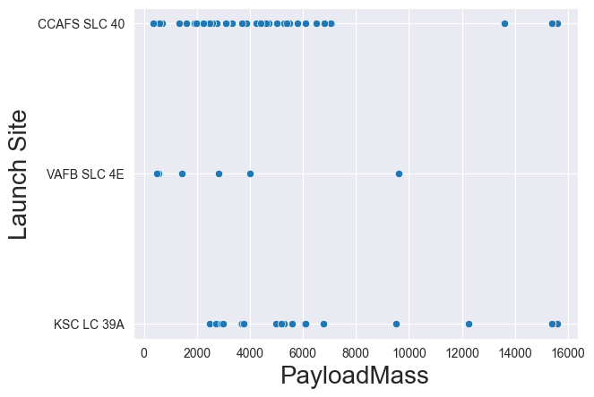
Payload vs. Launch Site
sns.scatterplot(df, x="PayloadMass", y="LaunchSite")
plt.xlabel("PayloadMass",fontsize=20)
plt.ylabel("Launch Site",fontsize=20)
plt.show()

Slide 20
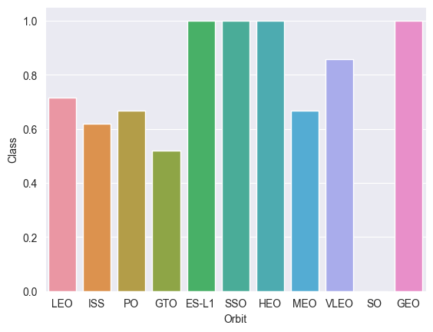
Success Rate vs. Orbit Type
df1 = df.groupby(pd.Grouper(key="Orbit")).mean()
sns.barplot(df1, x = df1.index, y = 'Class')

Slide 21
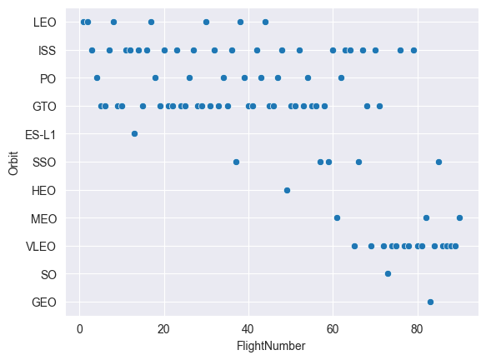
Flight Number vs. Orbit Type
sns.scatterplot(df, x= 'FlightNumber', y= 'Orbit')

Slide 22
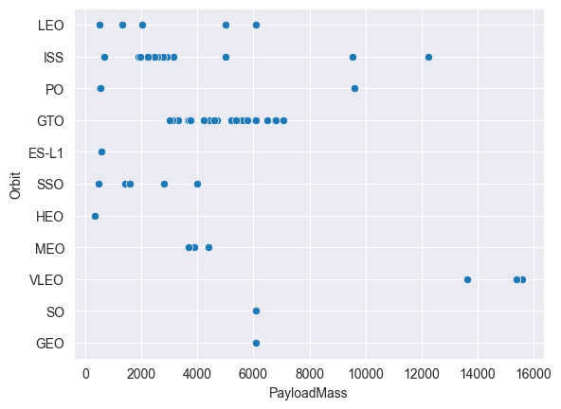
Payload vs. Orbit Type
sns.scatterplot(df, x= 'PayloadMass', y= 'Orbit')

Slide 23
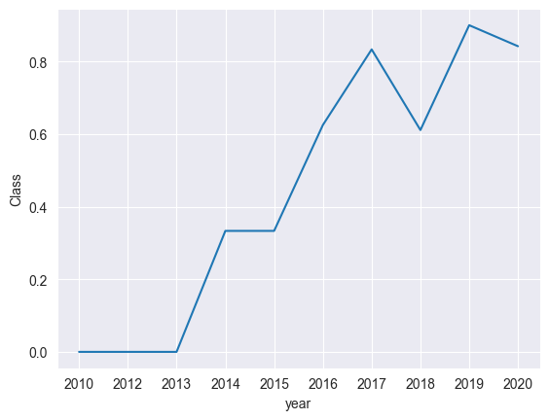
Launch Success Yearly Trend
df2 = df.groupby(pd.Grouper(key="year")).mean()
sns.lineplot(df2, x = df2.index, y = 'Class')

Slide 24
All Launch Site Names
Q= """
SELECT DISTINCT(Launch_Site) FROM SPACEXTBL
"""
cur.execute(Q)
pd.read_sql_query(Q,conn)
 | Launch_Site
0 | CCAFS LC-40
1 | VAFB SLC-4E
2 | KSC LC-39A
3 | CCAFS SLC-40

Slide 25
Launch Site Names Begin with 'CCA'
Q= """
SELECT * FROM SPACEXTBL
WHERE Launch_Site LIKE 'CCA%'
LIMIT 5
"""
cur.execute(Q)
pd.read_sql_query(Q,conn)
Date | Time (UTC) | Booster_Version | Launch_Site | Payload | PAYLOAD_MASS__KG_ | Orbit | Customer | Mission_Outcome | Landing _Outcome
0 | 04-06-2010 | 18:45:00 | F9 v1.0 B0003 | CCAFS LC-40 | Dragon Spacecraft Qualification Unit | 0 | LEO | SpaceX | Success | Failure (parachute)
1 | 08-12-2010 | 15:43:00 | F9 v1.0 B0004 | CCAFS LC-40 | Dragon demo flight C1, two CubeSats, barrel of... | 0 | LEO (ISS) | NASA (COTS) NRO | Success | Failure (parachute)
2 | 22-05-2012 | 07:44:00 | F9 v1.0 B0005 | CCAFS LC-40 | Dragon demo flight C2 | 525 | LEO (ISS) | NASA (COTS) | Success | No attempt
3 | 08-10-2012 | 00:35:00 | F9 v1.0 B0006 | CCAFS LC-40 | SpaceX CRS-1 | 500 | LEO (ISS) | NASA (CRS) | Success | No attempt
4 | 01-03-2013 | 15:10:00 | F9 v1.0 B0007 | CCAFS LC-40 | SpaceX CRS-2 | 677 | LEO (ISS) | NASA (CRS) | Success | No attempt

Slide 26
Total Payload Mass
Q= """
SELECT SUM(PAYLOAD_MASS__KG_) FROM SPACEXTBL
WHERE Customer = 'NASA (COTS)'
"""
cur.execute(Q)
pd.read_sql_query(Q,conn)
 | SUM(PAYLOAD_MASS__KG_)
0 | 525

Slide 27
Average Payload Mass by F9 v1.1
Q= """
SELECT AVG(PAYLOAD_MASS__KG_) FROM SPACEXTBL
WHERE Booster_Version = 'F9 v1.1'
"""
cur.execute(Q)
pd.read_sql_query(Q,conn)
 | AVG(PAYLOAD_MASS__KG_)
0 | 2928.4

Slide 28
First Successful Ground Landing Date
Q= """
SELECT Date FROM SPACEXTBL
WHERE Mission_Outcome = 'Success'
LIMIT 1
"""
cur.execute(Q)
pd.read_sql_query(Q,conn)
 | Date
0 | 04-06-2010

Slide 29
Successful Drone Ship Landing with Payload between 4000 and 6000
Q= """
SELECT Booster_Version FROM SPACEXTBL
WHERE PAYLOAD_MASS__KG_ BETWEEN 4000 AND 6000
"""
cur.execute(Q)
pd.read_sql_query(Q,conn)
 | Booster_Version
0 | F9 v1.1
1 | F9 v1.1 B1011
2 | F9 v1.1 B1014
3 | F9 v1.1 B1016
4 | F9 FT B1020
5 | F9 FT B1022
6 | F9 FT B1026
7 | F9 FT B1030
8 | F9 FT B1021.2
9 | F9 FT B1032.1
10 | F9 B4 B1040.1
11 | F9 FT B1031.2
12 | F9 B4 B1043.1
13 | F9 FT B1032.2
14 | F9 B4 B1040.2
15 | F9 B5 B1046.2
16 | F9 B5 B1047.2
17 | F9 B5 B1046.3
18 | F9 B5B1054
19 | F9 B5 B1048.3
20 | F9 B5 B1051.2
21 | F9 B5B1060.1
22 | F9 B5 B1058.2
23 | F9 B5B1062.1

Slide 30
Total Number of Successful and Failure Mission Outcomes
Q= """
SELECT Mission_Outcome, COUNT(*) FROM SPACEXTBL
GROUP BY Mission_Outcome
"""
cur.execute(Q)
pd.read_sql_query(Q,conn)
Mission_Outcome | COUNT(*)
0 | Failure (in flight) | 1
1 | Success | 98
2 | Success | 1
3 | Success (payload status unclear) | 1

Slide 31
Boosters Carried Maximum Payload
Q= """
SELECT Booster_Version FROM SPACEXTBL
WHERE PAYLOAD_MASS__KG_ IN (SELECT MAX(PAYLOAD_MASS__KG_) FROM SPACEXTBL)
"""
cur.execute(Q)
pd.read_sql_query(Q,conn)
Booster_Version
0 | F9 B5 B1048.4
1 | F9 B5 B1049.4
2 | F9 B5 B1051.3
3 | F9 B5 B1056.4
4 | F9 B5 B1048.5
5 | F9 B5 B1051.4
6 | F9 B5 B1049.5
7 | F9 B5 B1060.2
8 | F9 B5 B1058.3
9 | F9 B5 B1051.6
10 | F9 B5 B1060.3
11 | F9 B5 B1049.7

Slide 32
2015 Launch Records
Q= """
SELECT substr(Date,4,2), `Landing _Outcome`, Booster_Version, Launch_Site FROM SPACEXTBL
WHERE substr(Date,7,4) = '2015' AND `Landing _Outcome` = 'Failure (drone ship)'
"""
cur.execute(Q)
pd.read_sql_query(Q,conn)
 | substr(Date,4,2) | Landing _Outcome | Booster_Version | Launch_Site
0 | 01 | Failure (drone ship) | F9 v1.1 B1012 | CCAFS LC-40
1 | 04 | Failure (drone ship) | F9 v1.1 B1015 | CCAFS LC-40

Slide 33
Rank Landing Outcomes Between 2010-06-04 and 2017-03-20
Q= """
SELECT * FROM SPACEXTBL
WHERE `Landing _Outcome` LIKE 'Success%'
"""
cur.execute(Q)
df1 = pd.read_sql_query(Q,conn)
df1['Date'] = df1['Date'].astype("datetime64[ns]")
df4 = df1[df1['Date'] < '20-03-2017']
df4.sort_values('Date')
explanation here
Date | Time (UTC) | Booster_Version | Launch_Site | Payload | PAYLOAD_MASS__KG_ | Orbit | Customer | Mission_Outcome | Landing _Outcome
0 | 2015-12-22 | 01:29:00 | F9 FT B1019 | CCAFS LC-40 | OG2 Mission 2 11 Orbcomm-OG2 satellites | 2034 | LEO | Orbcomm | Success | Success (ground pad)
3 | 2016-05-27 | 21:39:00 | F9 FT B1023.1 | CCAFS LC-40 | Thaicom 8 | 3100 | GTO | Thaicom | Success | Success (drone ship)
2 | 2016-06-05 | 05:21:00 | F9 FT B1022 | CCAFS LC-40 | JCSAT-14 | 4696 | GTO | SKY Perfect JSAT Group | Success | Success (drone ship)
4 | 2016-07-18 | 04:45:00 | F9 FT B1025.1 | CCAFS LC-40 | SpaceX CRS-9 | 2257 | LEO (ISS) | NASA (CRS) | Success | Success (ground pad)
1 | 2016-08-04 | 20:43:00 | F9 FT B1021.1 | CCAFS LC-40 | SpaceX CRS-8 | 3136 | LEO (ISS) | NASA (CRS) | Success | Success (drone ship)
5 | 2016-08-14 | 05:26:00 | F9 FT B1026 | CCAFS LC-40 | JCSAT-16 | 4600 | GTO | SKY Perfect JSAT Group | Success | Success (drone ship)
9 | 2017-01-05 | 11:15:00 | F9 FT B1032.1 | KSC LC-39A | NROL-76 | 5300 | LEO | NRO | Success | Success (ground pad)
6 | 2017-01-14 | 17:54:00 | F9 FT B1029.1 | VAFB SLC-4E | Iridium NEXT 1 | 9600 | Polar LEO | Iridium Communications | Success | Success (drone ship)
7 | 2017-02-19 | 14:39:00 | F9 FT B1031.1 | KSC LC-39A | SpaceX CRS-10 | 2490 | LEO (ISS) | NASA (CRS) | Success | Success (ground pad)
10 | 2017-03-06 | 21:07:00 | F9 FT B1035.1 | KSC LC-39A | SpaceX CRS-11 | 2708 | LEO (ISS) | NASA (CRS) | Success | Success (ground pad)

Slide 34

Section 3

Slide 35
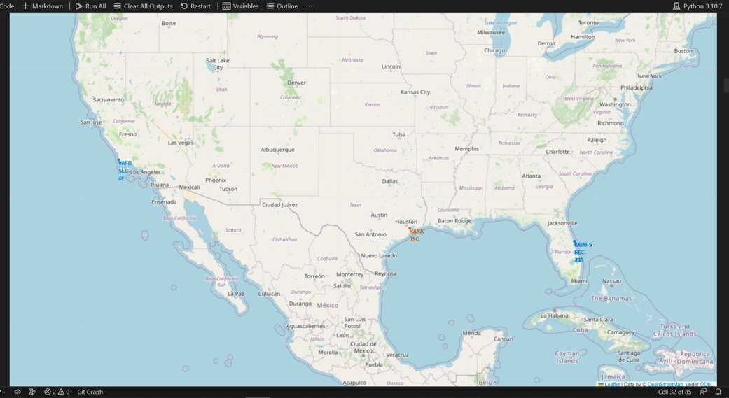
All launch sites’ location markers on a global map
>

Slide 36
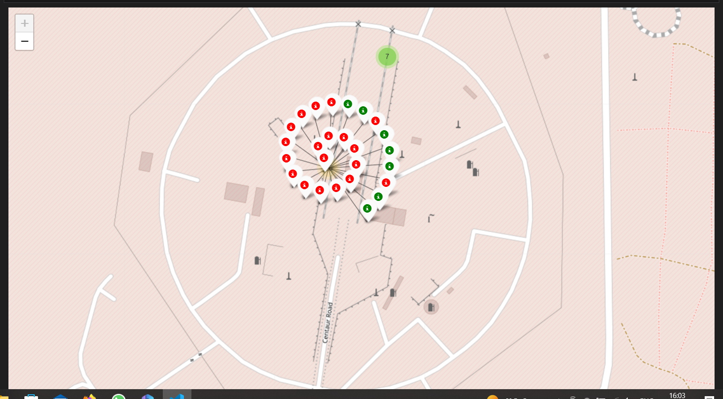
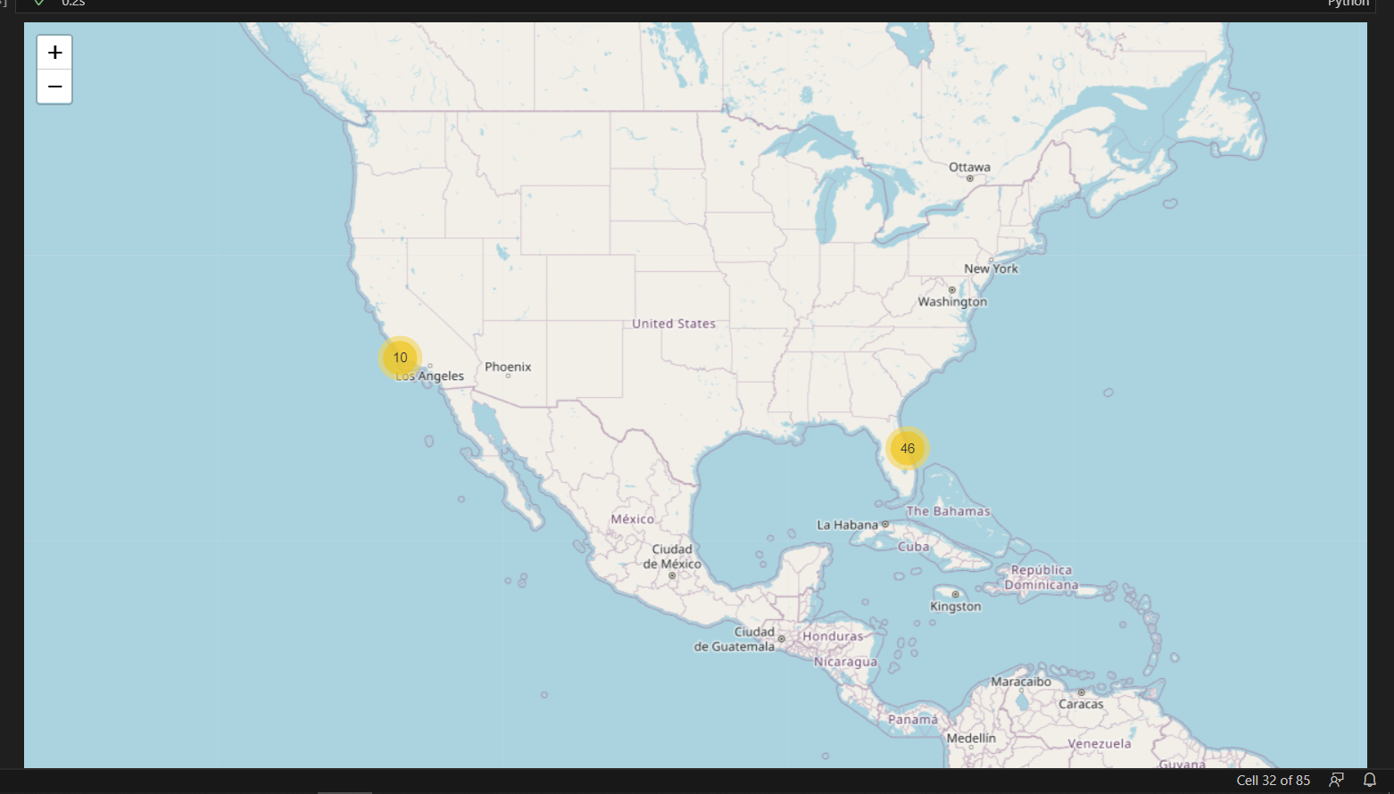
Mark the success/failed launches for each site on the map

Slide 37
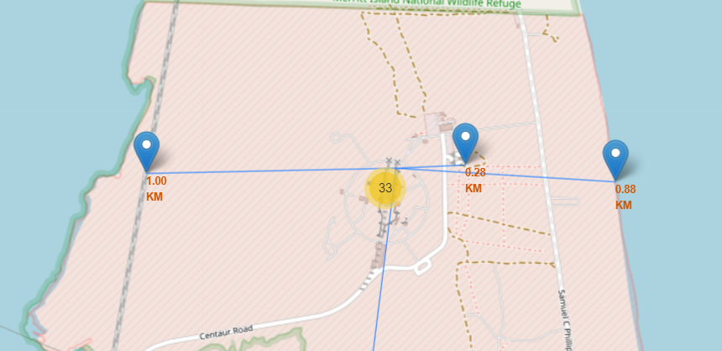
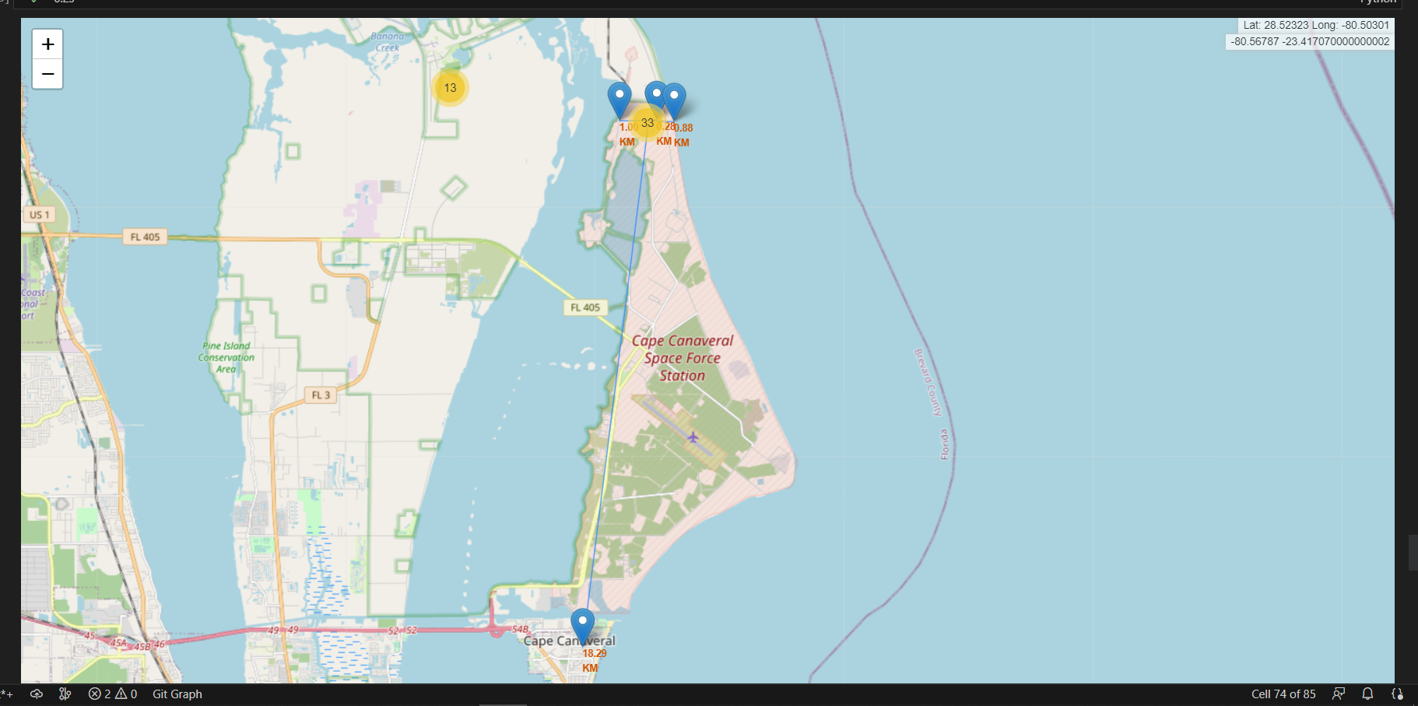
Folium Map
I draw a line between a launch site to its closest city, railway, highway

Slide 38

Section 4

Slide 39
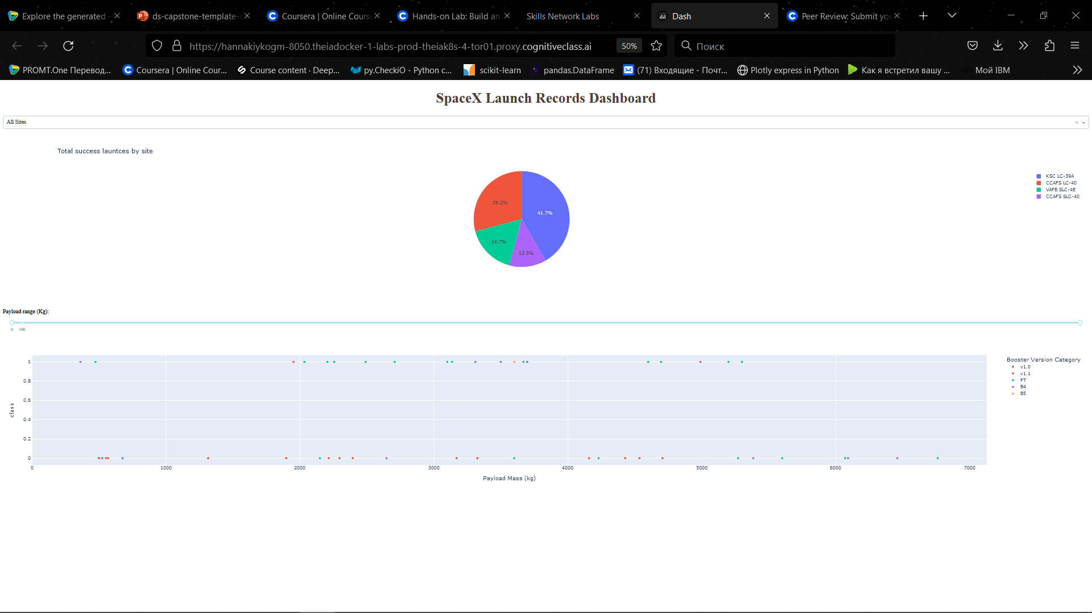
Dashboard

Slide 40
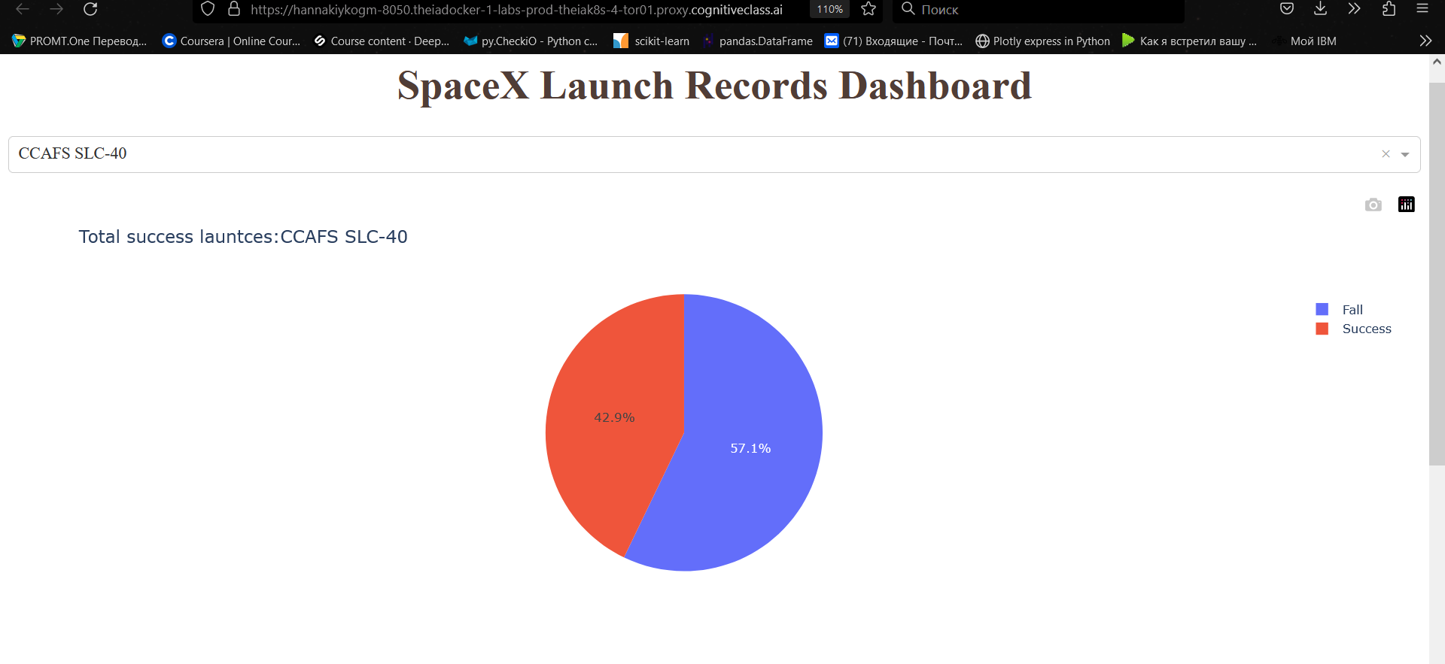
the largest successful launches
CCAFS SLC-40

Slide 41
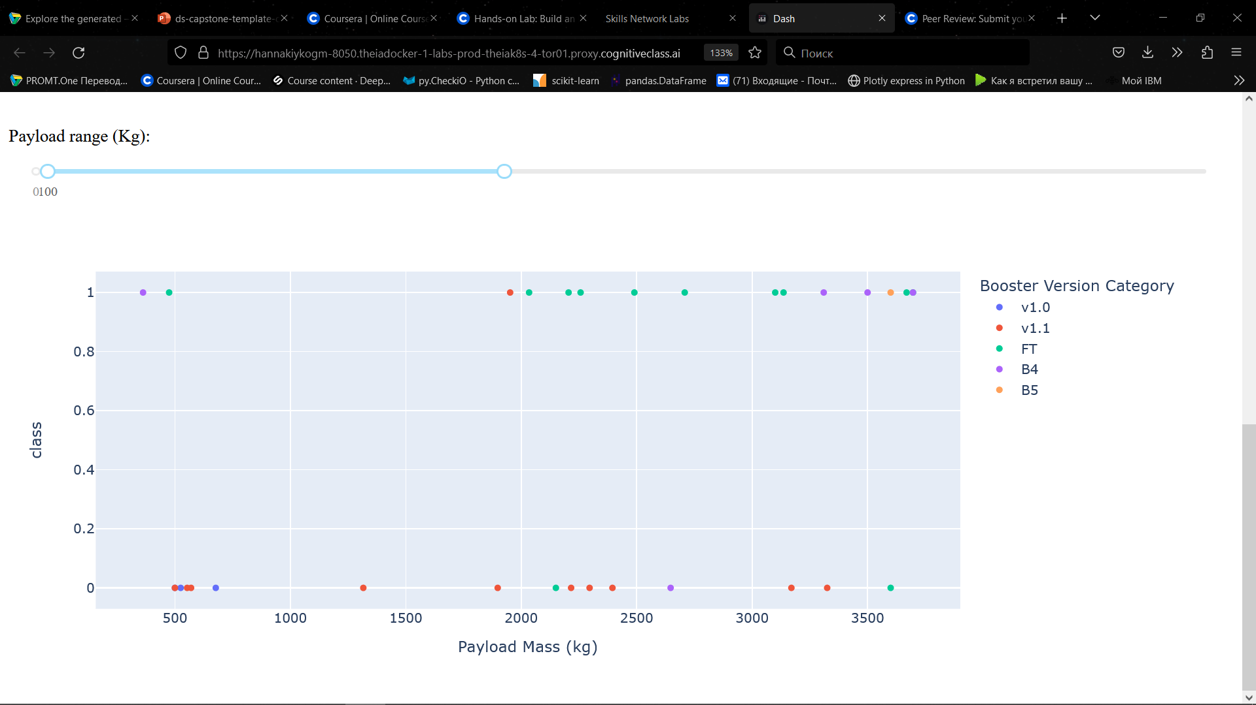
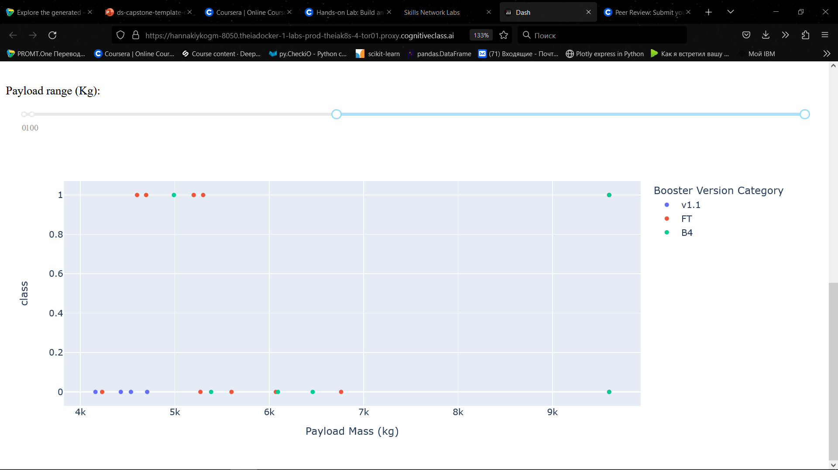
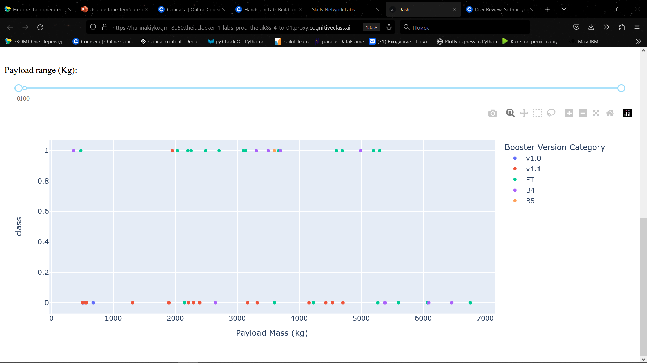
The answer for the following questions:
Which payload range(s) has the highest launch success rate?
Which payload range(s) has the lowest launch success rate?

Slide 42

Section 5

Slide 43
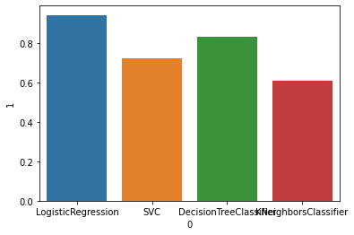
Classification Accuracy

Slide 44
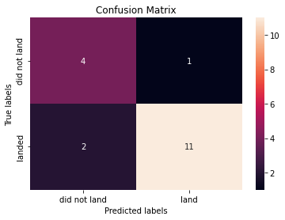
Confusion Matrix

Slide 45
Conclusions
Now, we can predict the result with high accuracy!

Slide 46

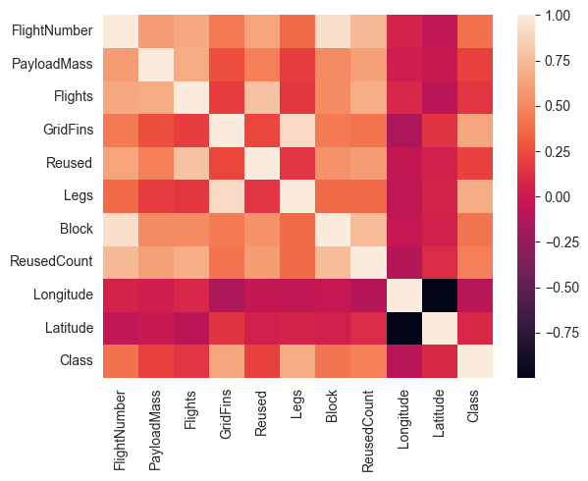
Appendix

Slide 47


